Slide 1
Elmer FEM – Dakota Interface
Anjali Sandip, Ph.D.
Senior Lecturer
Department of Mechanical Engineering
University of North Dakota
Notes:
1

Slide 2
Scope
Traditionally, multi-physics simulation software programs lack tools for uncertainty quantification and optimization ¹
Growing body of research - > multi-physics simulation software programs + uncertainty quantification and optimization ^{2,3}
Study objective: Integrate open-source software programs -- DAKOTA for optimization and uncertainty quantification and ELMER⁴ for multi-physics/phase/scale simulations -- and apply it to benchmarks
Impact: Applications of the integrated computational environment span several industries ranging from aerospace and energy to healthcare and manufacturing
[1]. Di Gallo, L., Reux, C., Imbeaux, F., Artaud, J. F., Owsiak, M., Saoutic, B., ... & Duchateau, J. L. (2016). Coupling between a multi-physics workflow engine and an optimization framework. Computer Physics Communications, 200, 76-86.
[2]. Witte, I., Stephanopoulos, K., Wray, T., & Agarwal, R. K. (2018). Uncertainty Quantification of Turbulence Model Coefficients in OpenFOAM and Fluent for Mildly Separated Flows. In 2018 Fluid Dynamics Conference (p. 3553).
[3]. Elwasif, W. R., Bernholdt, D. E., Pannala, S., Allu, S., & Foley, S. S. (2012, December). Parameter sweep and optimization of loosely coupled simulations using the DAKOTA toolkit. In Computational Science and Engineering (CSE), 2012 IEEE 15th International Conference on (pp. 102-110). IEEE.
[4]. Lyly, M., Ruokolainen, J., & Järvinen, E. (1999). ELMER–a finite element solver for multiphysics. CSC-report on scientific computing, 2000, 156-159.

Slide 3

Coupling methodology
PRE-PROCESSING
RUN
POST-PROCESSING
Dakota gui project workspace
Elmer project workspace
Dakota gui project workspace
params.in
Elmer
simulation input file
Elmer
results file
results.out
dprepro
ElmerSolver
cp
simulation.template
Yellow – Changes every evaluation
Purple -- Created once
Blue -- Operations

Slide 4
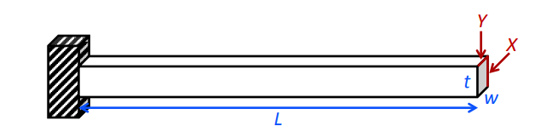
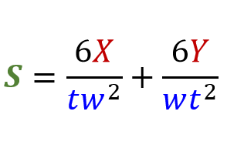
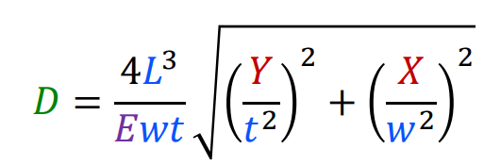
Cantilever beam - numerical model ^{6,7}
Parameters:
L: length (m)
W: width (m)
T: thickness (m)
ρ: density (kg/m³)
E: Young’s modulus (N/m²)
X: horizontal load (N)
Y: vertical load (N)
Responses:
M: mass (kg)
S: stress (Pa)
D: displacement (m)
M = ρ × w ×t ×L
[6]. Bayoumi, S. (2018). Engineering solid mechanics: fundamentals and applications. Routledge.
[7]. Sandia Dakota (2015). Sandia Dakota training materials. Retrieved from https://dakota.sandia.gov/training/dakota-training-materials

Slide 5
Cantilever beam – Finite element (FE) model in Elmer
PRE-PROCESSING
External package
Build 3D CAD + mesh
Module ⁴
Geometry | Rectangular block (L × w × t)
Mesh | Mesh element type – quadratic hexahedral elements Mesh size – 6073 nodes, 1200 elements
Simulation setup | Steady-state 3-dimensional Cartesian coordinates
Equation | Linear elasticity theory
Material | Steel ⁸ Density = 8000 kg/m³ Young’s modulus = 2.0e11 Pa
Loads and boundary conditions | Loads – pressure distributed uniformly over the cross-sectional area on the free end in the X and Y directions Boundary conditions – same as numerical model
Elmer GUI
Build FE model
RUN
Elmer Solver
Build FEM solution
POST-PROCESSING
ParaView
View results
[8]. MatWeb (1996 – 2019). Steel, General Properties. Retrieved from http://www.matweb.com/search/datasheet.aspx?bassnum=MS0001&ckck=1

Slide 6
Benchmark examples - outline
Benchmarks
Flow around a cylinder
Induction heating of a graphite crucible
Temperature distribution of toy glacier (2D, steady state)
Matlab* + Dakota
Elmer + Dakota
Uncertainty quantification/Latin hypercube sampling (LHS)
Constrained optimization
Compare results
* Numerical models (benchmarks) were implemented in Matlab

Slide 7
Benchmark example 1 – Latin Hypercube Sampling/Cantilever beam
Dakota input file
#Latin hypercube sampling (LHS)/Cantilever beam
method
sampling
sample_type lhs
samples 400
seed 1987
#number of probability levels for mass, displacement and stress
num_probability_levels = 0 13 13
probability_levels = 0.01 0.05 0.1:0.1:0.9 0.95 0.99
0.01 0.05 0.1:0.1:0.9 0.95 0.99
#response levels for mass (kg), displacement (m) and stress (Pa)
response_levels = 0 2.6e-5 3.5e8
Problem statement:
Determine -
1. the effects of 10% error in beam geometry on stress and displacement
2. fraction of samples that violate these constraints
displacement < 2.6e-5 m
stress < 350 MPa (steel/yield stress)

Slide 8
Dakota input file
#Latin hypercube sampling (LHS)/Cantilever beam
variables
#uncertain variables follow normal distribution
normal_uncertain 3
#uncertain variables – length (m), width (m), thickness (m)
descriptors 'L' 'w' 't'
means 0.127 0.05 0.05
std_deviations 0.0127 0.005 0.005
#fixed parameters – Young’s modulus (Pa), density (kg/m3), horizontal load (N), vertical load (N)
continuous_state 4
descriptors 'E' 'p' 'X' 'Y'
initial_state 2.0e11 8000 1560 2225
responses
# simulation output – mass (kg), displacement (m), stress (Pa)
response_functions 3
descriptors 'mass' 'displacement' 'stress'
no_gradients
no_hessians

Slide 9
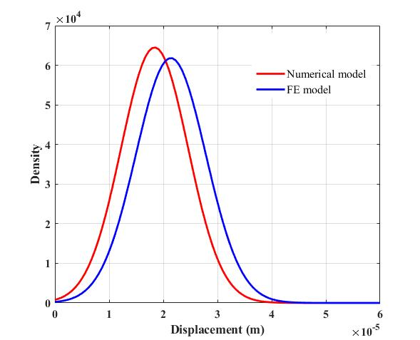
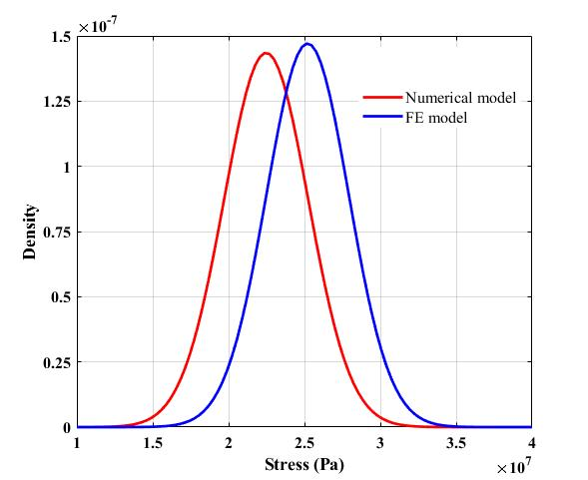
Benchmark example 1 – Results
 | Numerical model | FE model
Mass (kg) | 2.54 + 0.44 | 2.54 + 0.44
Displacement (m) | 1.84e-05 + 0.61 | 2.13e-05 + 0.65
Stress (Pa) | 2.24e+07 + 0.27 | 2.52e+07 + 0.27
Probability density functions (pdf) - displacement and stress

Slide 10
Benchmark example 1 – Results
Fraction of samples that violate the displacement and stress constraints
 | Numerical model | FE model
displacement | 13.5% | 25.5%
stress | 0% | 0%

Slide 11
Benchmark example 2 – Constrained optimization of cantilever beam
Dakota input file
# Constrained optimization of cantilever beam
method
optpp_newton
variables
continuous_design 2
#design variables - width (m), thickness (m)
descriptors 'w' 't'
initial_point 0.05 0.05
upper_bounds 0.1 0.1
lower_bounds 0.01 0.01
#fixed parameters – length (m), young’s modulus (Pa), density (kg/m3), horizontal load (N), vertical load (N)
continuous_state 5
descriptors 'L' 'E' 'p' 'X' 'Y'
initial_state 0.127 2.0e11 8000 1560 2225
Problem statement: Minimize the mass of the cantilever beam by 10% subject to following constraints
- 0.01 m < Width < 0.1 m
- 0.01 m < thickness < 0.1 m

Slide 12
Benchmark example 2 – Constrained optimization of cantilever beam
Dakota input file
# Constrained optimization of cantilever beam
responses
# simulation output – mass (kg), displacement (m), stress (Pa)
descriptors 'mass' 'displacement' 'stress'
#minimize mass
objective_functions 1
#upper bounds on displacement and stress
nonlinear_inequality_constraints 2
nonlinear_inequality_upper_bounds 2.6e-5 3.5e8
numerical_gradients
numerical_hessians
#uncomment for conmin_mfd, optpp_q_newton, optpp_fd_newton
#no_hessians
Problem statement: Minimize the mass of the cantilever beam by 10% subject to following constraints
- displacement < 2.6e-5 m
- stress < 350 MPa (steel/yield stress)

Slide 13
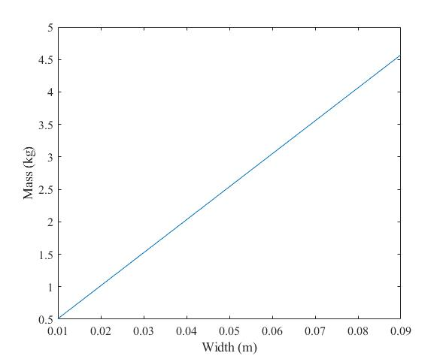
Benchmark example 2 – Constrained optimization method selection
Optimization method selection criteria –
Smooth
Local minima
Continuous variables
Bound constraints
Nonlinear inequality constraints
Selected method type = Gradient based local

Slide 14
Benchmark example 2 - Results: Gradient-based local methods
Model type | Method name | Width (m) | Thickness (m) | Mass (kg) | Displacement (m) | Stress (Pa) | Function evaluations (#)
Numerical model | conmin_mfd | 0.01 | 0.01 | 0.109 | 3.75e-04 | 1.02e+08 | 22
 | optpp_q_newton | 0.05 | 0.05 | 2.54 | 1.64e-05 | 2.13e+07 | 18
 | optpp_fd_newton | 0.05 | 0.05 | 2.54 | 1.64e-05 | 2.13e+07 | 28
 | optpp_newton | 0.05 | 0.05 | 2.53 | 1.64e-05 | 2.13e+07 | 48
FE model | conmin_mfd | 0.01 | 0.01 | 0.11 | 4.02e-04 | 1.50e+08 | 22
 | optpp_q_newton | 0.05 | 0.05 | 2.54 | 2.02e-05 | 2.50e+07 | 18
 | optpp_fd_newton | 0.05 | 0.05 | 2.54 | 2.02e-05 | 2.50e+07 | 28
 | optpp_newton | 0.05 | 0.05 | 2.53 | 2.025e-05 | 2.50e+07 | 48

Slide 15
Benchmark example 2 - Results: Derivative-free local methods
Model type | Method name | Width (m) | Thickness (m) | Mass (kg) | Displacement (m) | Stress (Pa) | Function evaluations (#)
Numerical model | coliny_cobyla | 0.01 | 0.05 | 0.95 | 7.11e-05 | 3.65e+07 | 7
 | coliny_pattern_search | 0.01 | 0.01 | 0.10 | 4.09e-04 | 1.06e+08 | 93
 | coliny_solis_wets | 0.01 | 0.01 | 0.10 | 4.03e-04 | 1.06e+08 | 89
 | mesh_adaptive_search | 0.03 | 0.04 | 1.5 | 2.59e-05 | 2.69e+07 | 184
FE model | coliny_cobyla | 0.01 | 0.05 | 0.95 | 7.35e-05 | 3.99e+07 | 7
 | coliny_pattern_search | 0.01 | 0.01 | 0.10 | 4.37e-04 | 1.17e+08 | 74
 | coliny_solis_wets | 0.01 | 0.01 | 0.10 | 4.21e-04 | 1.11e+08 | 92
 | mesh_adaptive_search | 0.04 | 0.04 | 1.92 | 2.49e-05 | 2.79e+07 | 131

Slide 16
Conclusion
Study objective: Integrate open-source software programs -- DAKOTA for optimization and uncertainty quantification and ELMER⁴ for multi-physics/phase/scale simulations -- and apply it to benchmarks - achieved
Impact: Applications of the integrated computational environment span several industries ranging from aerospace and energy to healthcare and manufacturing
Future work: Apply the integrated computational environment to multi-physics/phase/scale benchmarks
Acknowledgements: Many thanks to the Dakota users mailing list and Elmer user forum

Slide 17
Thank you!
Questions?

